Slide 1
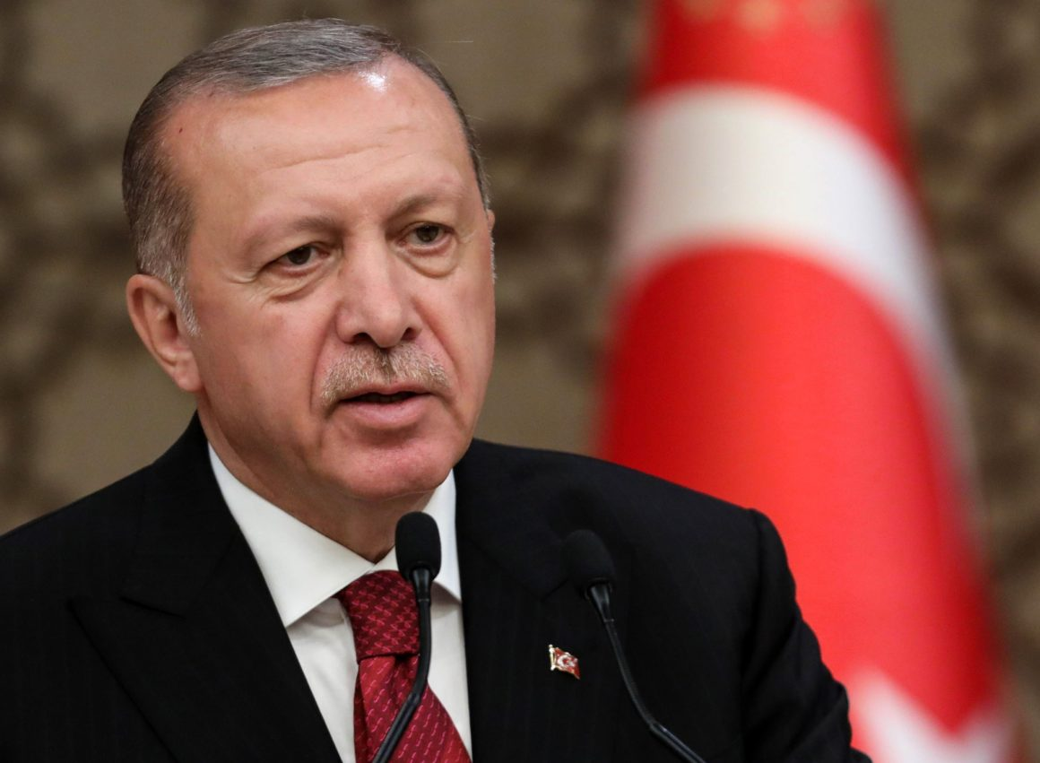
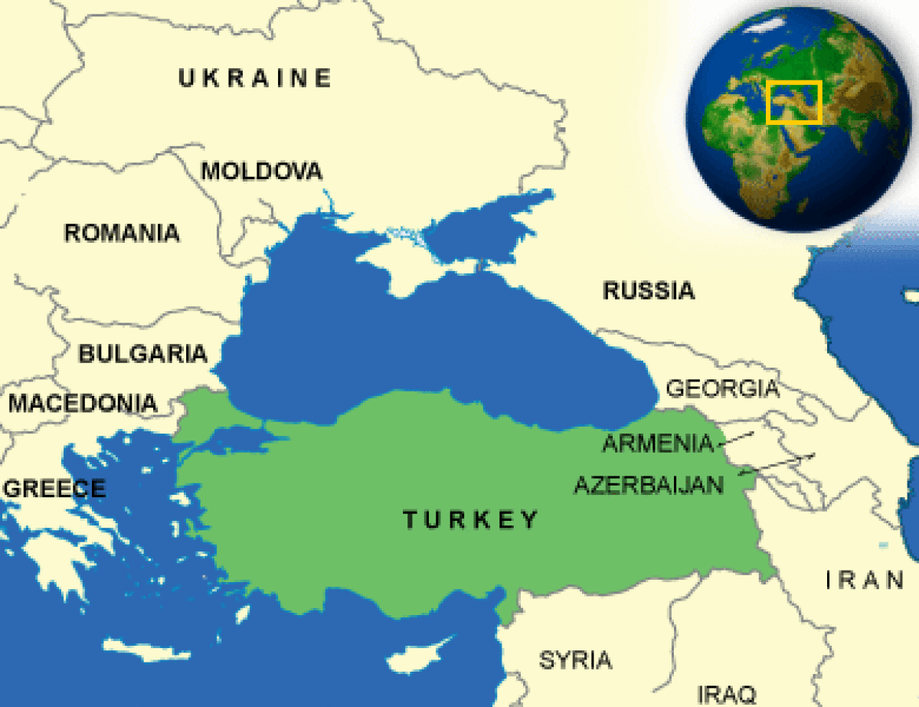
R. T. Erdogan, Turkey and Western Media
By Kaitlyn Waters and Giannis Koutroudes

Slide 2
Research Questions
How are R.T. Erdogan and Turkey portrayed in Western media (European, American)?
What are commonly used words and phrases in the media that are used to describe Turkey and Erdogan?
To what extent does orientalism play a factor in the discourse of Turkey and the European union?

Slide 3
Methodology
Online research (Newspapers, TV stories, magazine covers, peer-reviewed scholarly articles )
Semiotic analysis of images and videos

Slide 4
Media outlets examined
European media
American media
BBC
The Guardian
DW
The Economist
France 24
Le Monde
Le Point
The Independent
NYT
CNN
The Financial Times (FT)
NBC
Fox News

Slide 5
Headlines
“The beginning of the end for democracy in Turkey”, (The Independent, 25/6/2018)
“Turkey: suffocating climate of fear”, (The Guardian, 19/7/2018)
“Recep Tayyip Erdogan: le nouveau sultan”, (Le Figaro, 29/06/2018)
“Erdogan Triumph Takes Turkey Into the Era of One-Man Rule”, (Bloomberg, 24/06/2018)
“Turkey’s future is moving backwards”, (The New York Times, 24/09/2017)
“Turkey is sliding into dictatorship”, (The Economist, 25/4/2017)
“Turkish newspaper replaces editor after upsetting Erdogan”, (The Financial Times, 2/3/2017)

Slide 6
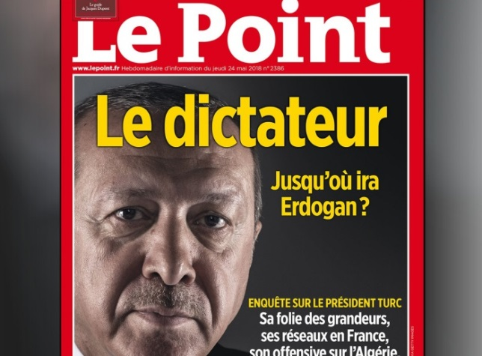
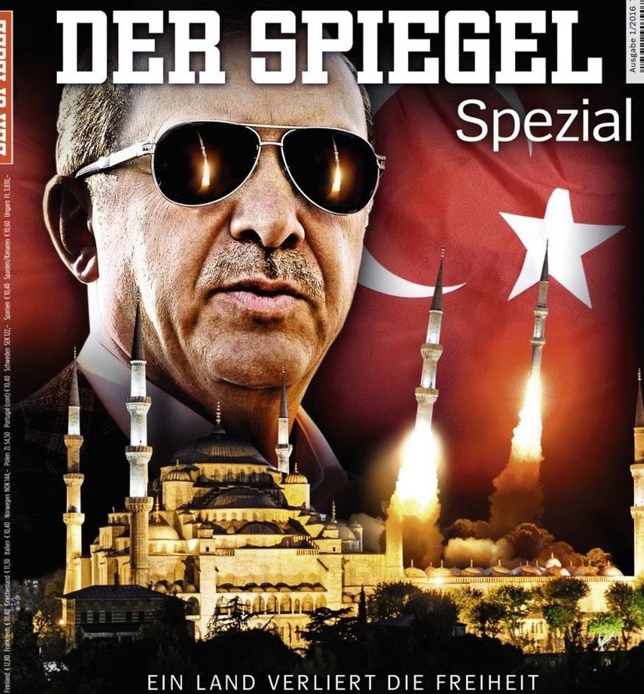
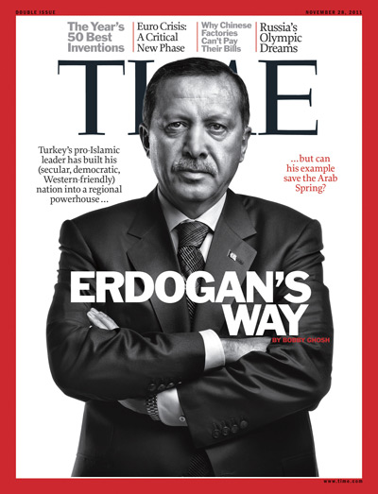
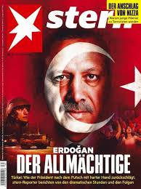
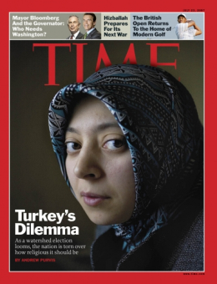
Magazine covers

Slide 7
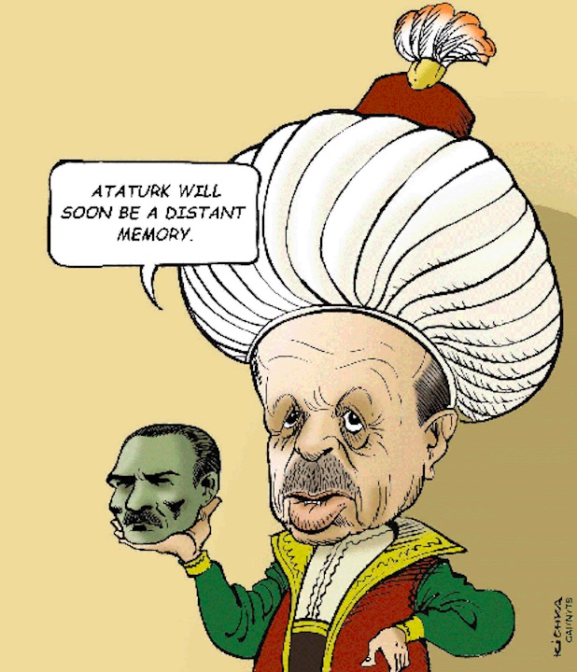
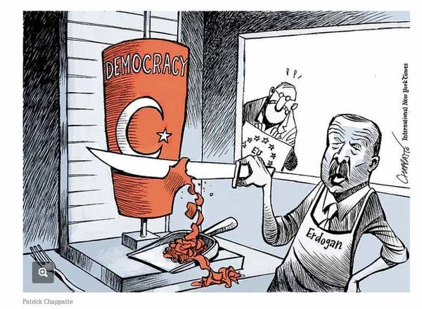
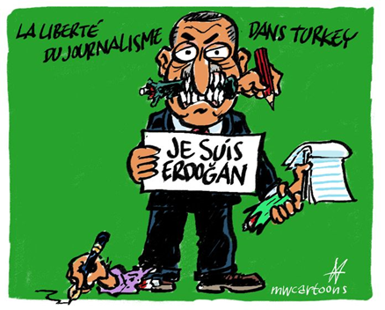
Cartoons
Sources: The Independent (UK), The New York Times (USA) and Charlie Hebdo (France)

Slide 8
Western media and Erdogan
Western media maintains a negative stance towards R. T. Erdogan. Erdogan is perceived as an authoritarian ruler who imposes harsh and conservative reforms upon its people.
Western media perpetuates a negative image of Erdogan and pinpoint the repercussions of his ascendancy to power. *The extensive coverage of the lira crisis clearly depicts the above point and the total control of the economy by Erdogan will negatively affect the country’s bilateral relations with the West and especially Trump’s USA.

Slide 9
Western media and Turkey
There is a distinction between the coverage of Turkey and Erdogan (separate columns for Erdogan and Turkey)
Turkey is seen through the prism of “Otherness”.
Orientalism dominates media coverage of Turkey.
American media portray Turkey as a disloyal ally, capable of jeopardizing US geopolitical interests in the Middle East (e.g. extensive coverage of Russo-Turkish relations and co-operation in Syria).

Slide 10
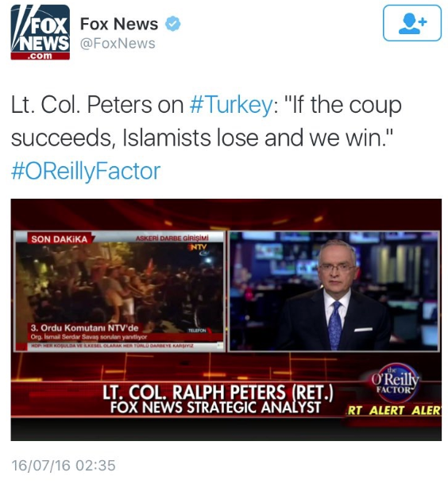
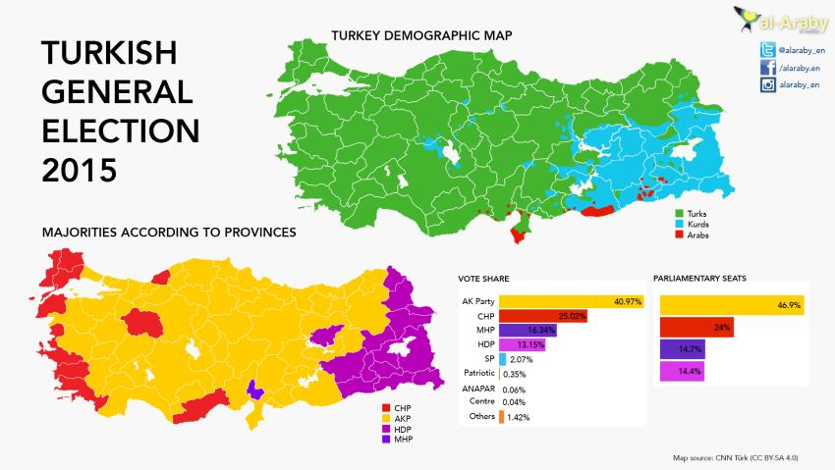
Orientalism, Islamophobia and Portrayal of “otherness”
- Orientalism theory (Edward Said) explained: https://www.youtube.com/watch?v=1aNwMpV6bVs - A “Muslim Democracy”

Slide 11
Conclusions
Mass media in Europe as well as the United States uses exclusionary discourse in their analysis of contemporary Turkish politics in an effort to distance themselves from both the problems the country faces as well as its people.
Orientalism still dominates political discourse and the cultural perception of Turkey and Erdogan in the West.

Slide 12
Bibliography
1.) Mustafa, Shehzade. “10 Shameful Examples of Western Media ‘Reporting’ On Turkey Coup.” MuslimMatters.org - Discourses in the Intellectual Traditions, Political Situation, and Social Ethics of Muslim Life, 16 July 2016, muslimmatters.org/2016/07/16/10-shameful-examples-of-western-media-reporting-on-turkey-coup/. 2.) Yildirim , A. “Erdoğan's Persistent Popularity.” Carnegie Endowment for International Peace, 13 June 2018, carnegieendowment.org/sada/76588

Slide 13
Topics for discussion
To what extent should “development” be taken into consideration for a country to join the European Union, why or why not? Who is in charge of deciding what is “development”?
How can EU countries and the United States improve their relations with Turkey?
What has changed in Turkey ever since Erdogan took power? What has happened to the Turkish model of democracy? Has Erdogan finally transformed Turkey?

