Slide 1
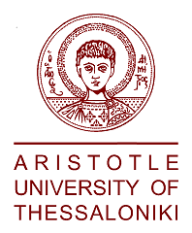
Cultural Diversity in the EU today
George Akilidis
Elena Alexandrou
Soukaina Anwar
Christos Chelidoni
Media & Diversity

Slide 2
Definitions
Culture is the characteristics and knowledge of a particular group of people, encompassing language, religion, cuisine, social habits, music and arts.
Cultural Diversity is the existence of a variety of cultural or ethnic groups within a society
Multiculturalism is a situation in which all the different cultural or racial groups in a society have equal rights and opportunities, and none is ignored or regarded as unimportant.

Slide 3
Today’s Risks in Europe
Rising intolerance
Rising support for xenophobic and populist parties
Discrimination
The presence of a population virtually without rights
Parallel societies
Islamic extremism
Loss of democratic freedoms
A possible clash between “religious freedom” and freedom of expression
Notes:
There have been identified 8 risks to Council of Europe values
Behind these risks, lie insecurity (resulting from Europe’s economic difficulties and sense of relative decline); the phenomenon of large-scale immigration (both as actually experienced and as perceived); distorted images and harmful stereotypes of minorities in the media and public opinion; and a shortage of leaders who can inspire confidence by articulating a clear vision of Europe’s destiny.

Slide 4
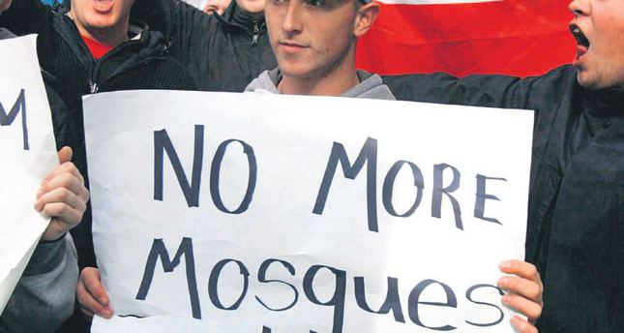
Rising intolerance
Is the phenomenon that causes us greatest alarm, and seems to be manifested in the hostile and discriminatory treatment to which members of various groups are subjected in Europe today.
LGBT
Roma
Immigrants and asylum seekers
Muslims
Jews
Christians (“Heretics”)
Other minority groups (national and religious minorities)

Slide 5
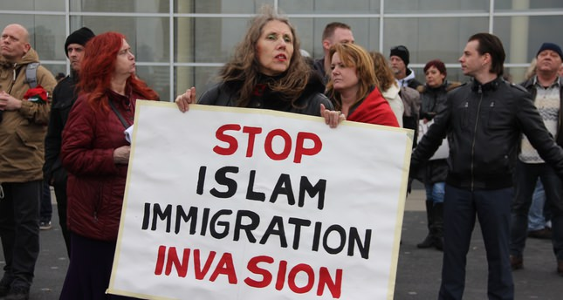
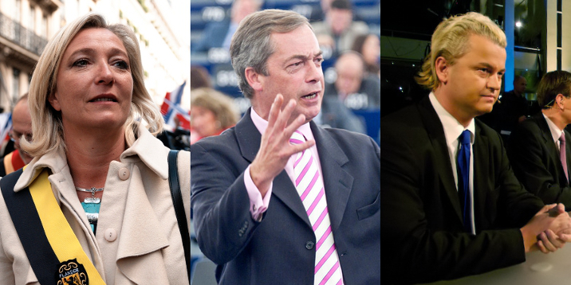
Rising support for xenophobic and populist parties
There is no doubt that significant social and ideological changes are taking place in Europe’s political landscape.
Political parties in different parts of Europe express political prejudices and encourage intolerance
From northern Europe to the Mediterranean, we are witnessing a wave of radical populism.
Notes:
In this section, we can find the political parties in different parts of Europe that have appeared, or significantly increased their percentages in the elections, by giving political expression to these prejudices and encouraging them.
The rise of such parties, and their impact on “mainstream” politics, is probably the phenomenon that has caused greatest anxiety among European
liberals, prompting the fear that Europe as we know it now might be at risk.
There is no doubt that significant social and ideological changes are taking place in Europe’s political landscape. From northern Europe to the Mediterranean, we are witnessing a wave of radical populism. The parties concerned are generally assigned to the right or far right of the political spectrum, but it would be a mistake to classify them as neofascist.
[While there are elements that connect them with the “traditional” neo-Nazi or neo-fascist movements of post-war Europe, which generally remained a marginal
phenomenon, the new parties have a much broader base, stretching into virtually all strata of society, regardless of education level, gender or status. They can appeal to almost anyone who feels that his or her livelihood and way of life is threatened by the economic crisis, and by immigration. In fact, some of them combine these xenophobic attitudes with an appeal to social liberalism, defence of the welfare state and seemingly left-wing economic policies (as well as strongly positive views of Israel). In western Europe, hostility to immigration is their common theme. In many central and eastern European countries, similar anxieties are directed against the Roma, and sometimes other national minorities, including Jews.]

Slide 6
Discrimination
Discrimination appears to be especially widespread, and to have very harmful effects in :
Employment
Housing
Education
Healthcare and social services
Actions of the police and law courts.
Notes:
Prejudice against immigrants, people of recent migrant origin or members of minorities is frequently reflected in discrimination, whereby the people concerned are denied services or advantages to which they are entitled, and which are accorded to members of other groups. Such treatment serves to alienate them and contributes to their isolation from the rest of society. It is contrary to the fundamental principles to which all member states of the Council of Europe are committed, and is in itself one of the most serious obstacle sto the establishment or maintenance of open and harmonious societies in Europe.
Discrimination appears to be especially widespread, and to have very harmful effects, in the following areas: employment; housing;education; healthcare and social services; and the actions of the police and law courts.

Slide 7
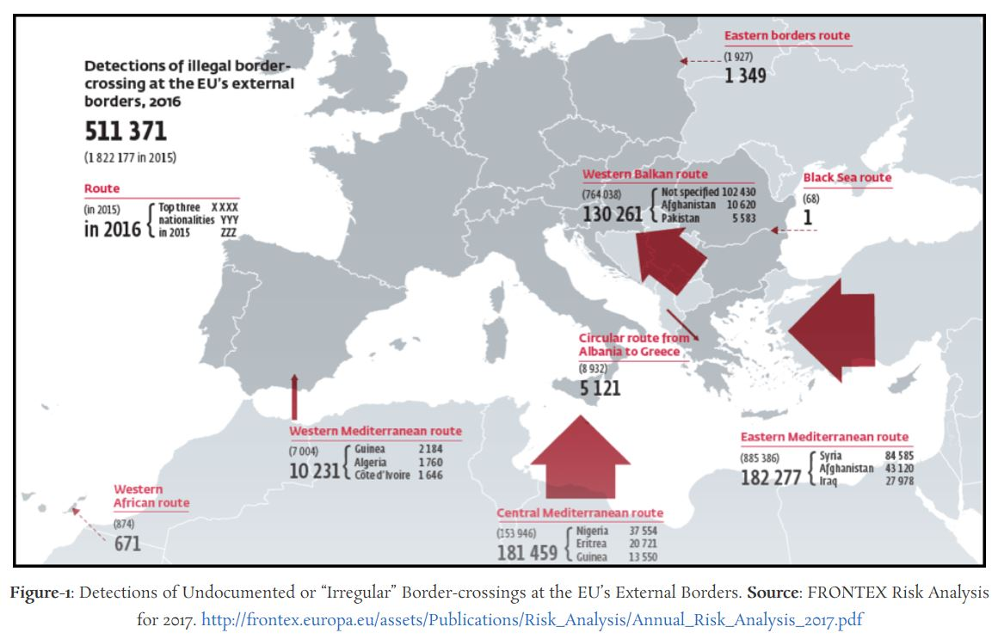
The presence of a population virtually without rights
“Illegal”, “irregular” or “undocumented” migrants
Notes:
Europe’s relative prosperity and its shrinking domestic workforce continue to create employment opportunities which tempt more and more
migrants to come. The effect is to create more illegal migration. A semi-secret existence which makes it difficult to collect reliable data about them, but their numbers are certainly high. This is a population denied not only his civil and political rights, but in practice even the most basic human rights. The law threatens them with deportation and so they are vulnerable to every kind of exploitation. At the same time their “illegal” status makes them even more unpopular than other immigrants with the rest of the population.

Slide 8
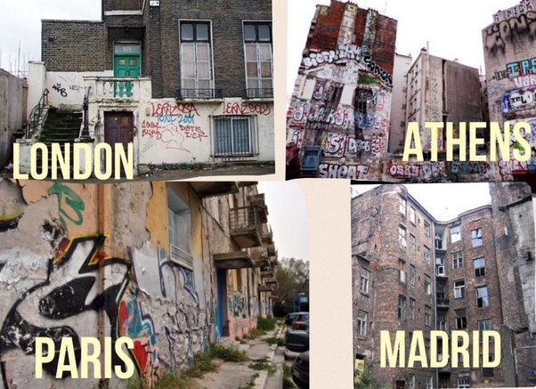
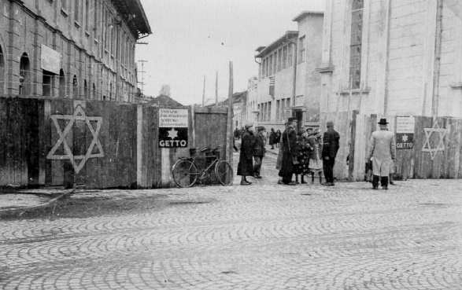
Parallel societies
It is harmful to any meaningful notion of
“living together”
Notes:
The word “ghetto”, which historically referred to the Jewish quarter of various European cities, is used today to denote a compact urban district where members of ethnic, religious, national or other communities, which are minorities on the national level, form a large majority of the local population.
The term “ghetto”, is usually applied in a more disparaging sense, when a district becomes largely separated from the rest of the city, in conditions of social and
economic exclusion.

Slide 9
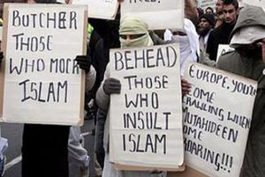
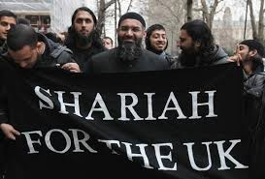
Islamic extremism
Islamic extremism reinforces, and appears to justify, fear and resentment of Muslims among the non-Muslim population.
Notes:
Although Islam has existed in Europe for many years, the 9/11 terrorist attacks in the United States, as well as subsequent similarly dramatic attacks in Europe which have increased the last years, have given rise to the perception that terrorism is a feature of Islam as such. It is sometimes even claimed that “not all Muslims are terrorists, but most of the are”
The existence of Islamic extremism (not only terrorism but also groups and preachers who denounce western values or call for “jihad”) is a serious threat to peaceful coexistence between Muslims and non-Muslims in Europe.
It reinforces, and appears to justify, fear and resentment of Muslims among the non-Muslim population.

Slide 10
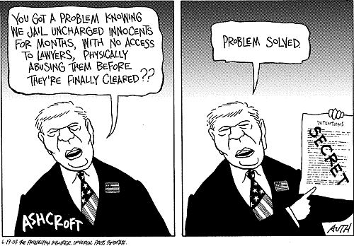
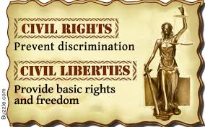
Loss of democratic freedoms
Civil liberties are the essential prerequisite of democracy
The overreaction of the state and the imposition of excessive controls do indeed represent a serious risk to the health and strength of our European democracies.
Notes:
Suffering by the twin fear of being “swamped” by an uncontrolled influx of immigrants and/or massacred by Islamic terrorists, Europeans look to the state to protect them, and political leaders fear they have little chance of re-election if they are seen to fail on either front. States are thus under constant pressure to tighten controls on immigration and to keep potential or suspected terrorists under very close observation. Too often, it is assumed that there is a direct trade-off between security and civil liberties, and governments feel obliged to restrict civil liberties in the hope of guaranteeing the security.

Slide 11
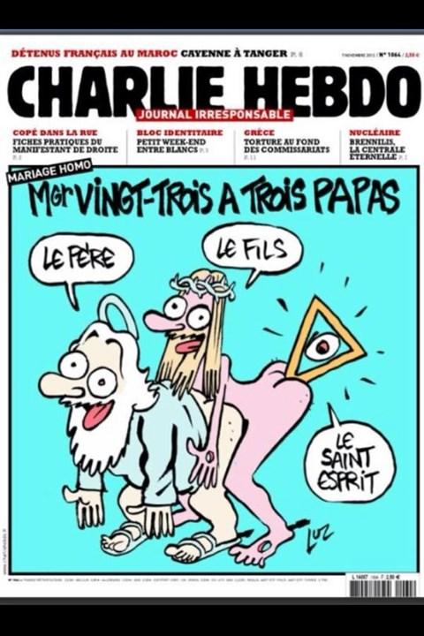
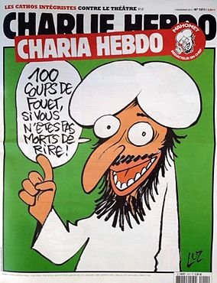
A possible clash between “religious freedom” and freedom of expression
There is thus a danger that a fundamental freedom, that of expression, may come to be eroded through the anxiety of some European elites to avoid making hostile an important minority, or through the fear of provoking acts of violence.

Slide 12
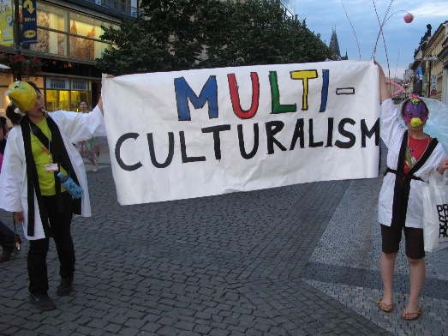
Statistics about multiculturalism in Europe
There are 87 distinct peoples of Europe
33 form the majority population in at least one sovereign state
54 constitute ethnic minorities
The total number of national or linguistic minority populations in Europe is estimated at 105 million people, or 14% of 770 million Europeans.
Notes:
The Indigenous peoples of Europe are the focus of European ethnology, the field of anthropology related to the various indigenous groups that reside in the nations of Europe. According to German monograph Minderheitenrechte in Europa co-edited by Pan and Pfeil (2002) there are 87 distinct peoples of Europe, of which 33 form the majority population in at least one sovereign state, while the remaining 54 constitute ethnic minorities. The total number of national or linguistic minority populations in Europe is estimated at 105 million people, or 14% of 770 million Europeans.[
But the refugee crisis has highlighted a historical fact: Europe’s cultural, ethnic and religious diversity will increase in a transformative way in the years and decades to come.

Slide 13
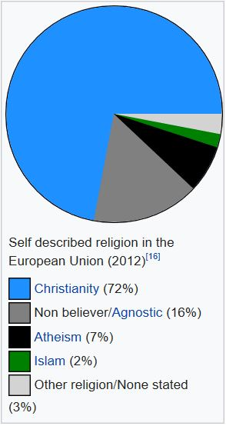
Religion
Christianity is the largest religion in the European Union, accounting for 72% of the EU's population
Notes:
Christianity is still the largest religion in Europe; according to a 2011 survey, 76.2% of Europeans considered themselves Christians. Also according to a study on Religiosity in the European Union in 2012, by Eurobarometer, Christianity is the largest religion in the European Union, accounting for 72% of the EU's population

Slide 14
Religion
Notes:
The refugee crisis has highlighted a historical fact: Europe’s cultural, ethnic and religious diversity will increase in a transformative way in the years and decades to come.
The world’s Muslim population is expected to increase by about 35% in the next 20 years, rising from 1.6 billion in 2010 to 2.2 billion by 2030, according to new population projections by the Pew Research Center’s Forum on Religion & Public Life.

Slide 15
“Clash of Civilizations” theory, islamophobia, religious freedom
The clash of civilizations ,This term refers to the political, economic and pluralistic differences between nation states during the post-Cold War era. These include Islamic, Chinese, Japanese, Indian, Western, African and Latin American civilizations.
The term Clash of Civilizations was published in 1993 by the American political scientist Samuel Huntington,he claims that since the end of the Cold War, it is identities and culture that engender conflict and alliances among states, not political ideologies. The world thus tends to divide into civilizations that encompass several states. So there is no coincidence between state and civilization. For Huntington, civilization is the largest cultural entity. It "is the highest mode of grouping and the highest level of cultural identity that humans need to distinguish themselves from other species. It is defined at the same time by objective elements, such as language, history, religion, customs, institutions, and by subjective elements of self-identification. "

Slide 16
The cultural shock is real and exists in many countries. Belgium, Singapore, Switzerland, the Baltic countries,Bosnia etc. are privileged places of the interactive culture shock.,they seem to have had the purpose of staging a common intercultural life, of orchestrating cultural shocks in a peaceful and innovative way, of managing plurality in unity. Moreover, it should be noted that in general these countries become the centers of peaceful cultural shock and enriching after centuries of shocks of conflict cultures.

Slide 17
These small countries differ from the major countries of the continental hinterland, of which they are the cape. We are talking here about the geopolitical heart of cultural nationalism, of these countries with vast populated, fluvial metropolises, proud of their imperial past immemorial, state, militarized and centralized. These large countries have for a long time been globally, and on a popular scale, closed to external cultural influences or to migrant and tourist flows ( Russia, Turkey etc)

Slide 18
Alexandre del Valle, a French author, says that the countries of Europe share almost the same cultures and values, so it would be difficult to give them that term. He gave an example of his country, France, which succeeded in grouping Germins, and celts. He gave examples of himself: "We were Sicilians immigrants in Tunisia then Algeria, then Spain then we were integrated in France without any problem. immigrants who come from different parts of the world, enrich the European culture and create more diversity, and cultural shock and that is where the term is best placed.

Slide 19
Le Temps,ch
In Great Britain, we notice the difficulties of integration of the Pakistani community, which has about 750 000 people. Pakistanis of origin are those who have been least involved with ethnic British. "It is the ethnic minority that has the least economic success," says Christian Dustmann, professor at the Center for Research and Analysis of Migration. Women in particular are not very active in the labor market. "According to a study conducted for the Ministry of the Interior, Pakistani immigrants are those with the least English proficiency. Urdu is still widely used in most households.

Slide 20
The guardian
« Happy as an Indian in the UK”
Statistics show that Indian citizens or their descendants are the happiest of His Majesty's kingdom. A journalist from the Guardian visited a contractor of Indian origin to find out the keys to this inclination to happiness.
This community of about 1.4 million people - the largest minority in the country - scores an average of 7.5 out of 10 for life.
White Britons and people identified as Chinese are then the happiest with a "rating" of happiness of 7.4 out of 10.
Black communities are the least happy, with only 6.7 out of 10.

Slide 21
Multiculturalism
The Old Debate

Slide 22
Historic Background (W.W II- 70’s)
- Post- Colonialism period (...) - Anti- Nazism/ Anti- Facism (...) - Immigration and refugee issue (…) →Multiculturalism viewed as anti-racism

Slide 23
EU (EEC)
→Established to maintain peace in the continent →Promise for prosperity + economic growth for all member states →Common marketplace, BUT each state: maintain its identity

Slide 24
As integration and enlargement processes progressed… (‘United in Diversity’)
✔Schengen Treaty (1985) ✔Freedom of movement (1992) ✔Ten new countries entering- enlargement (2004) ✔ Article 13 of the EU Treaty of Amsterdam (1999) ✔ European Council on Tolerance and Reconciliation (2008) ✔Act on Equal Treatment (2006→Germany, 2011 → Poland) ✔Ombudsman office establishment

Slide 25
New Debate
After the 2000’s: - A stray of events→ against multiculturalism - Integration (under ‘our’ values),
in terms of - culture and - religion

Slide 26
Change of attitude as depicted on EU’s main state leaders public statements→ Failure of Multiculturalism?
A. Merkel: “The multicultural concept is a failure, an absolute failure.” (Oct. 2010) D. Cameron: Calling for “a lot less of the passive tolerance of recent years and much more active, muscular liberalism”. (2010) N. Sarkozy: “We’ve been too concerned about the identity of new arrivals and not enough about the identity of the country receiving them”.

Slide 27
Main issues leading towards the declining of multiculturalism..
- Terrorist attacks [Islamophobia (..)] - Financial Crisis, Refugee Crisis, etc.. - Debates:
Cartoon crisis Veil/burka Minarets Refugees Ghettos, etc..
-Media : stereotyping + populism

Slide 28
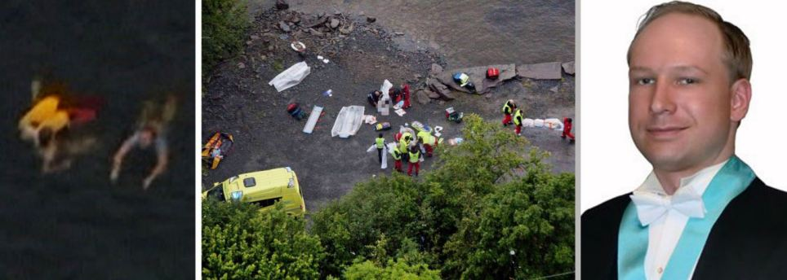
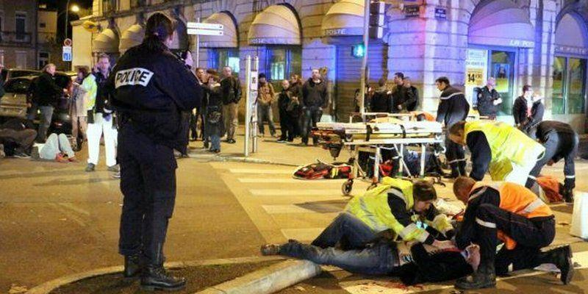
Terrorist attack in Oslo, 2011 (the anti-immigrant, nationalist, far-right ‘fun’ Anders Breivik).
Terrorist attack in Paris, Nov. 2015 (ISIS members).

Slide 29
Rise of Nationalism and Far Right Political Parties
- Economic Crisis + Refugee Crisis→ Nationalist Parties on the rise - Issues of preserving our national identity and unemployment → anti-immigration sentiments. - Gained power both in national Parliaments and in the European one.

Slide 30
Multiculturalism: Is it necessary and how it can be preserved
‘Without that sense of common interest, multi-national states eventually fall apart, and I imagine that the EU will prove no different.’ (E. West, March 2016, The Spectator)
Solution to ‘failed’ multiculturalism: To ‘uphold both liberal conceptions of individual freedom and pluralistic communitarianism’, ‘with each acting as a check on the other’. (M. Ruthven, August 2017, Financial Times)

Slide 31
What about Integration of Refugees-Immigrants in Europe though?
George Akilidis
MA Student
“Media & Diversity”
Course
Notes:
All these terms, definitions, such as multiculturalism, religion, ethnicity, race, migration (that have been analyzed previously by my teammates) are inseparable with the notion of INTEGRATION.
So, where does all this leave asylum seekers, refugees and irregular migrants in Europe?

Slide 32
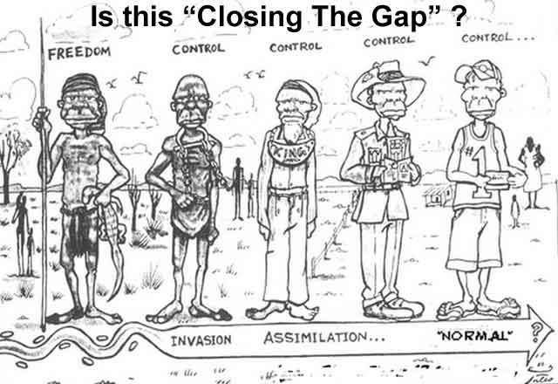
Assimilation Vs Integration
Notes:
Firstly, I strongly believe that it is absolutely necessary to start my part of this presentation by clarifying to you the notions of integration and assimilation.
Assimilation is a process of absorbing minority communities into the ways and views of the majority community in a multicultural society. This is absorption that takes place in a one way direction as the minority communities are required to learn the customs and traditions of the majority community giving up their own or modifying them to become acceptable to the majority community. Assimilation has become a dirty word in some ways as it asks people belonging to a minority culture to give up on some aspects of their culture to adopt the ways of the majority culture to be accepted by the majority community. Thus, assimilation happens to be a process where the ethnic minority loses some of its features and adopts some of the features of the majority to appear like the majority community.

Slide 33
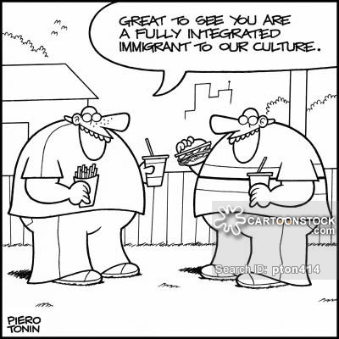
Assimilation Vs Integration
Notes:
Integration is a two way process where there are cross influences from both the cultures and both change a small bit to accept the minority culture into the majority culture. This is a process that requires acceptance of the laws and ways of the host country by the people of the minority culture without giving up on their own laws and ways. This happens with modification in both the cultures. However, this is possible in a situation where there are no antagonistic feelings between the two cultures and both accommodate the viewpoints of each other in a bid to live harmoniously together. Integration is a process where the minority cultures take something in from the majority culture to become a part of the majority culture retaining their identity.

Slide 34
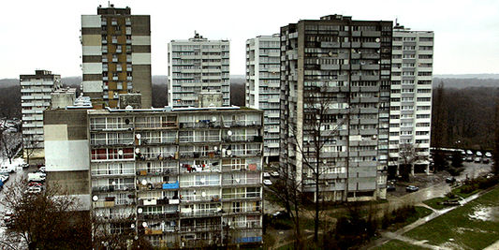
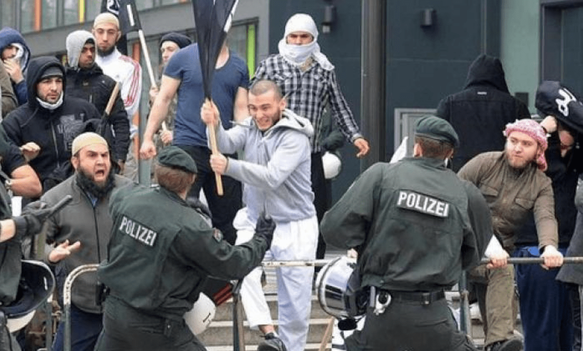
Realities in Integration of Refugees – Immigrants
Parallel Societies
Notes:
Migrants usually come together and live in specific suburbs, called Ghettos, where they can form a kind of community with people from the same national or religious origin. In these suburbs, they can get by, speaking only their mother language.
It is clear that ghettos are an obstacle to successful integration and this is why EU states should try to adopt policies to avoid them.
The emergence of parallel societies has several dangerous consequences. Social and economic deprivation can lead to unrest.
Such isolation contributes to mutual alienation between the society in question and the larger community surrounding it.

Slide 35
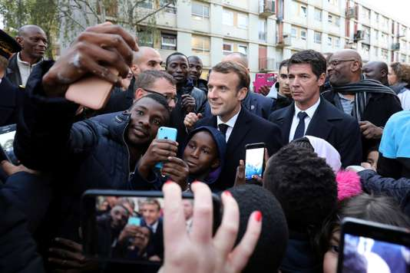
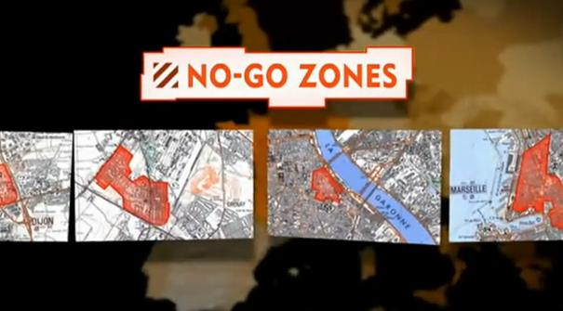
Realities in Integration of Refugees – Immigrants
Parallel Societies
Notes:
In France, for example, there are 717 ‘sensitive urban zones’, mostly in the suburbs of large cities (known as ‘banlieuses‘). These neighborhoods have twice the national rate of unemployment, over 35% of the inhabitants are below the national poverty line, and over 50% are of foreign origin. EUROSTAT confirms that, long term unemployment as a percentage of total unemployment, has increased for the non-EU-born population from 28.4 % in 2009 to 51.2 % in 2015, after a decrease from 2008 to 2009. It seems that the integration followed so far is somewhat failing.
http://ec.europa.eu/eurostat/statistics-explained/index.php/Unemployment_statistics

Slide 36
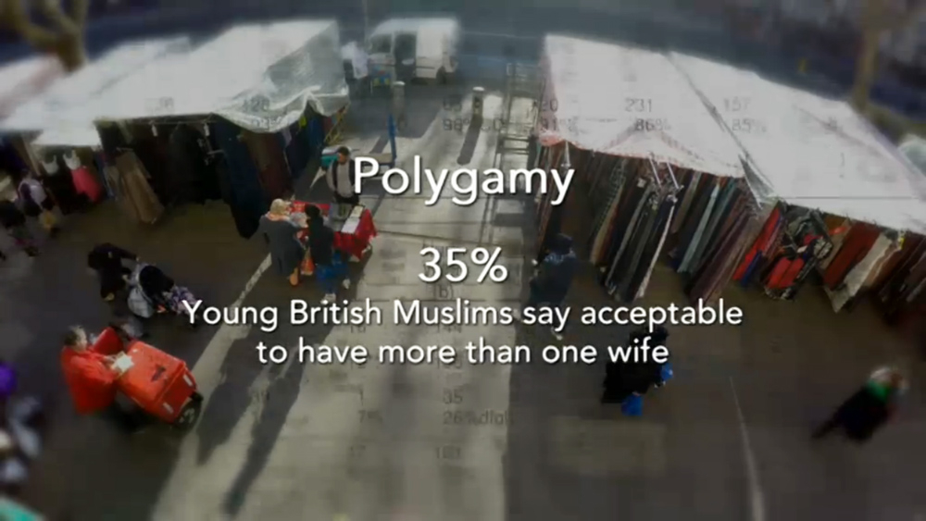
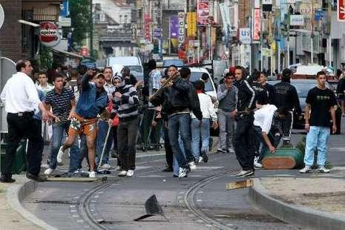
Realities in Integration of Refugees – Immigrants
Parallel Societies
https://www.youtube.com/watch?v=rP6U6Hhy_2M
Notes:
What about UK?
The effect of dense concentration of people of the same religious or national group, comes at a price.
For example, in a survey conducted by ICM Research, in 2016, in the UK for Channel 4, 23% of British Muslims said Islamic Sharia law should replace British law in areas with large Muslim populations.
Kern Soeren, (17 April 2016), UK: What British Muslims really think, Retrieved fromhttps://www.gatestoneinstitute.org/7861/british-muslims-survey
On social issues, almost a third (31%) of British Muslims surveyed in UK’s GHETOOS think polygamy should be legalized. Among 18-to-24-year-olds, 35% think it is acceptable to have more than one wife.

Slide 37
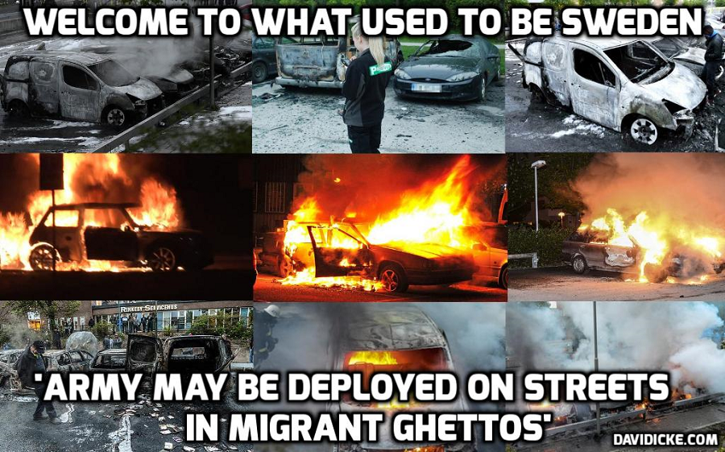
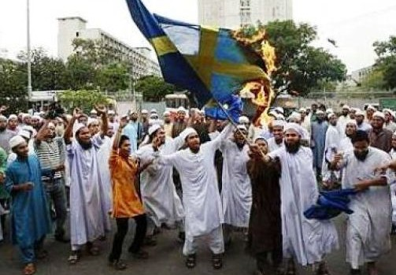
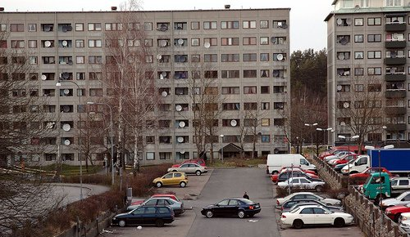
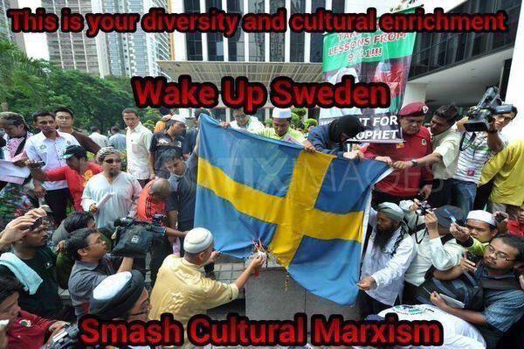
Realities in Integration of Refugees – Immigrants
The Case study of Sweden
Notes:
Let’s see what happened in Sweden…
Sorry for the chosen images which might be little bit frustrating.( I chose them on purpose)
Sweden is a case study worth focusing on.
Sweden has adopted some of the most generous immigration policies, which are essential to the image of a country that (like Canada) prides itself as a moral superpower.
In fact Sweden takes in more refugees per capita than any other EU country.
Immigrants – mainly from the Middle East and Africa – now make up about 16 per cent of the population, while questioning the political consensus over the issue of immigration is regarded as xenophobic and hateful.

Slide 38
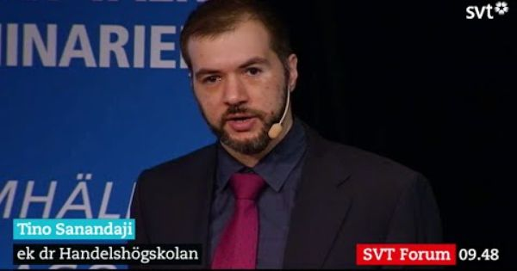
Realities in Integration of Refugees – Immigrants
The Case study of Sweden
Notes:
Tino Sanandaji, a Kurdish-Swedish economist and specialist on immigration issues observes, there has been a lack of integration among non-European refugees.
Forty-eight percent of immigrants of working age are unemployed. Even after 15 years in Sweden, their employment rates reach only about 60 percent. Sweden has the biggest employment gap in the EU between natives and non-natives. Forty-two percent of the long-term unemployed are immigrants while fifty-eight percent of welfare payments go to immigrants.
Forty-five percent of children with low test scores are immigrants. Immigrants on average earn less than 40 percent than Swedes do. The majority of people charged with murder, rape and robbery are either first- or second-generation immigrants. And that is not the fault of the Swedish state or of the immigrants. Sweden’s labor market is highly skills-intensive, and even low-skilled Swedes can’t get work.
The perceptions of risk from immigration are diverging and although the issue is intentionally ignored, realities and statistics eventually surface. According to a recent opinion poll, 58 per cent of Swedes believe there is too much immigration.
Sweden is a great case study for anyone who believes that the EU is capable of assimilating the hundreds of thousands of refugees and migrants who have arrived in the EU member states in just over a year or the millions more who are desperately poised to follow the same path.
Wente Margaret, (11 September 2015), Sweden’s Ugly Immigration problem, http://www.theglobeandmail.com/opinion/swedens-ugly-immigration-problem/article26338254/

Slide 39
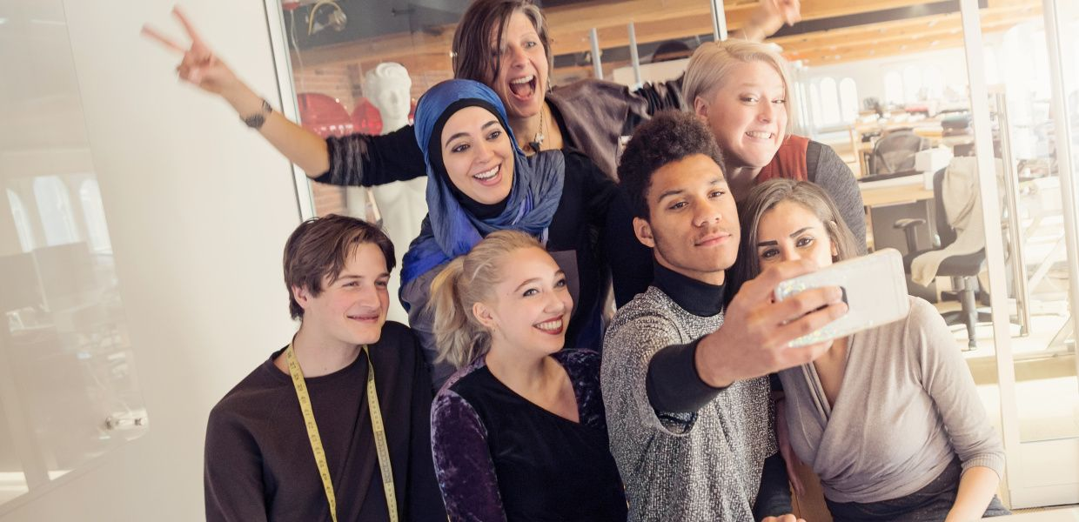
Realities in Integration of Refugees – Immigrants
The Optimistic Point of View
Religious affiliation does not impede integration
Strong connection with the new homeland
Notes:
According to the Bertelsmann Stiftung which is an independent foundation under private law, based in Gütersloh, Germany,
The integration of Muslim immigrants in Western Europe is making clear progress.
This is evident in the findings of this foundation, which investigated the language competence, education, working life and interreligious contacts of Muslims in France, the UK, Austria, Germany and Switzerland.
(kl) According to its survey, religious affiliation does not OR AT LEAST SHOULD NOT impede integration.
(kl) Another indication of successful integration is that 75 percent of Muslims regularly spend their free time with non-Muslims.
Interreligious contact also increases with each generation, as does identification with the receiving country.
Overall, nearly all of those surveyed (94 percent) feel connected to the country where they live.

Slide 40
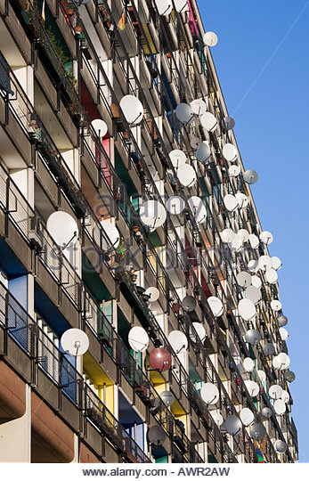
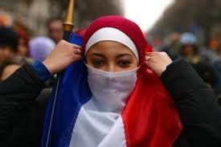
Proposals for
a Successful Integration Process
Notes:
Whatever the situation is, integration systems now face two challenges that mean that awareness of diversity is necessary:
(KL) the geographical concentration of minorities in underprivileged neighbourhoods
(KL) and the radicalisation of certain young people.
These challenges are forcing the States to develop towards a more pragmatic management of the problems caused by cohabitation, without relinquishing a universalist policy based on the practice of a common language, the respect of shared political principles and equal access to rights, housing and employment.

Slide 41
Proposals for
a Successful Integration Process
Provide integration services as soon as possible for those asylum seekers most likely to be allowed to stay
When dispersing humanitarian migrants across the country, take into account whether the jobs available in the particular regions match their skills
Pay particular attention to unaccompanied minors who arrive past the age of compulsory schooling
Let those asylum seekers likely to stay find employment
Deal with mental and physical health issues early
Acknowledge that integration can take a long time, particularly for the least educated
Notes:
There are innumerous proposals, core strategies for advancing integration and cohesion for a successful integration process, expressed by many actors, stakeholders, NGOs , International Institutions, etc.
I will mention, on purpose, only what the OECD Organization proposes, and not what is EU’ s plan on this:
The OECD report, Making Integration Work, takes stock of the experiences of its member countries and provides 10 lessons (from which I will mention six of them):
1. Provide integration services as soon as possible for those asylum seekers most likely to be allowed to stay
2. When dispersing humanitarian migrants across the country, take into account whether the jobs available in the particular regions match their skills
3. Pay particular attention to unaccompanied minors who arrive past the age of compulsory schooling
4. Let those asylum seekers likely to stay find employment
5. Deal with mental and physical health issues early
6. Acknowledge that integration can take a long time, particularly for the least educated

Slide 42
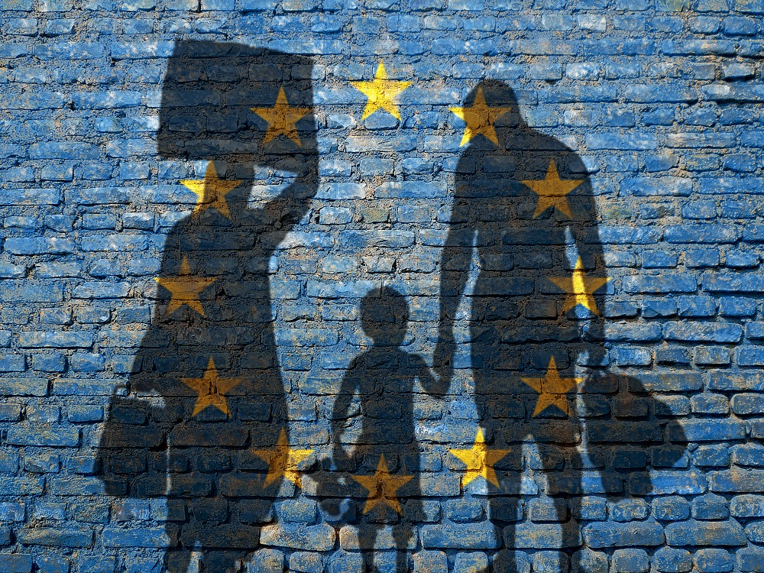
Proposals for
a Successful Integration Process
Notes:
Of course European Commission has also a new adopted Action Plan on the Integration of third country nationals, but
what we have to keep in mind is that
the countries and cultures of Europe have always been diverse and heterogeneous in their ethnic, religious and social composition.
(KL) The opening of borders, globalization of markets and production, worldwide migration and new communication technologies mean this trend will continue, even if populist and extremist forces on the right persist in their attempts to stir up antipathy and mobilize citizens against any acceptance of cultural heterogeneity.

Slide 43
Proposals – solution for a successful cultural diverse environment in Europe
"Making Europe a community characterized by inclusion and cohesion, civic and creative - challenges ahead for culture and education »
“Cultural identity is today more fluid and dynamic than ever. Internet and other digital means are the vectors of a true intercultural dialogue in Europe.
Traditional cultural boundaries are disintegrating and losing their meaning.Even language barriers, which are part of cultural signifiers, disappear gradually. In today's Europe, young people are exchanging and communicating increasingly without the institutions and the formal education system:
multicultural youth meets in rock concerts, tourist hotspots and huge rave parties.”

Slide 44
In the old cultural paradigm, history played a major role. Today, young people are interested in building meaningful social relations in the context of a new Europe without borders, much more than in debating the great events of the past. The majority of them understood that their personal and social success depended on their ability to communicate with and understand other cultures.
Intercultural learning is basically about teaching skills that can help build relationships. It is not a matter of learning what "different" cultures are, as an anthropologist or historian would do, but of experiencing the "other" through an interactive social dynamic. History and culture are no longer perceptual truths but reflections on relationships between cultures. And so, the quality of social relations is at the center of the cultural dialogue.

